Slide 1
Data Analytics & BI – Traditional Vs Modern Approach

Slide 2

About Me
Debdut Mukherjee
Working as an Azure Databricks and Datawarehouse developer at Tata Consultancy Services
Loves Data Analytics and a Machine Learning Enthusiast
Kann auch auf Deutsch (German) sprechen und liebt die Sprache und Kultur
LinkedIn: https://www.linkedin.com/in/debdutmukherjee/
Facebook: https://www.facebook.com/debdut.mukherjee

Slide 3




What is Business Intelligence?
Business intelligence (BI) comprises the strategies and technologies used by enterprises for the data analysis of business information.
Provide historical, current and predictive views of business operations.
Helps Business Analysts or CEOs to take key business decisions by referring to Dashboards.
What BI comprises of?
ETL
Analytics
Reporting

Slide 4
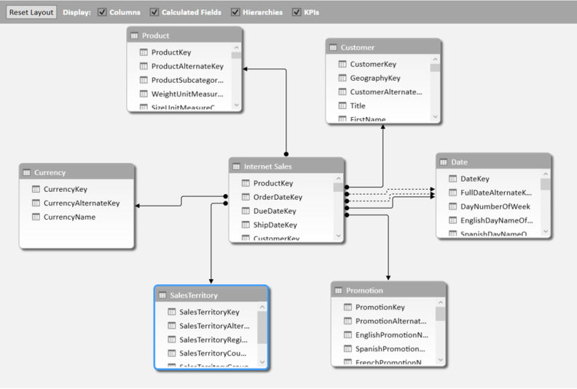
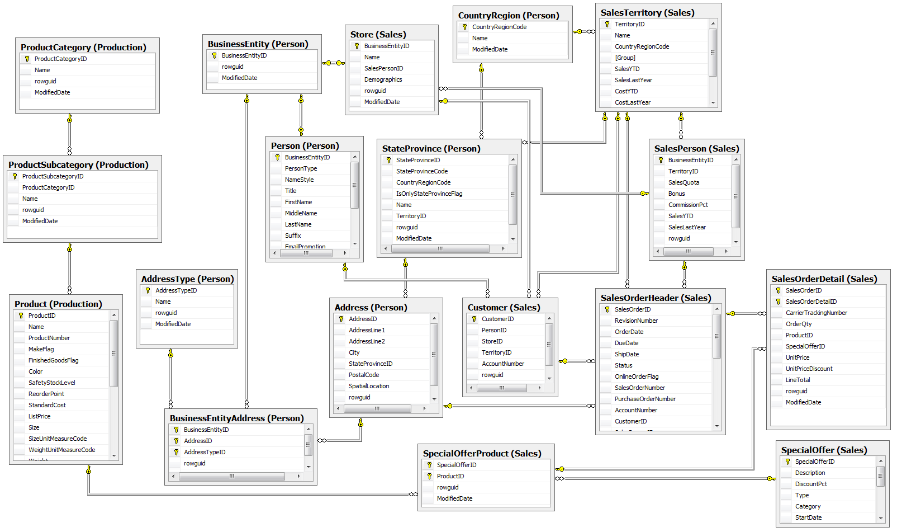
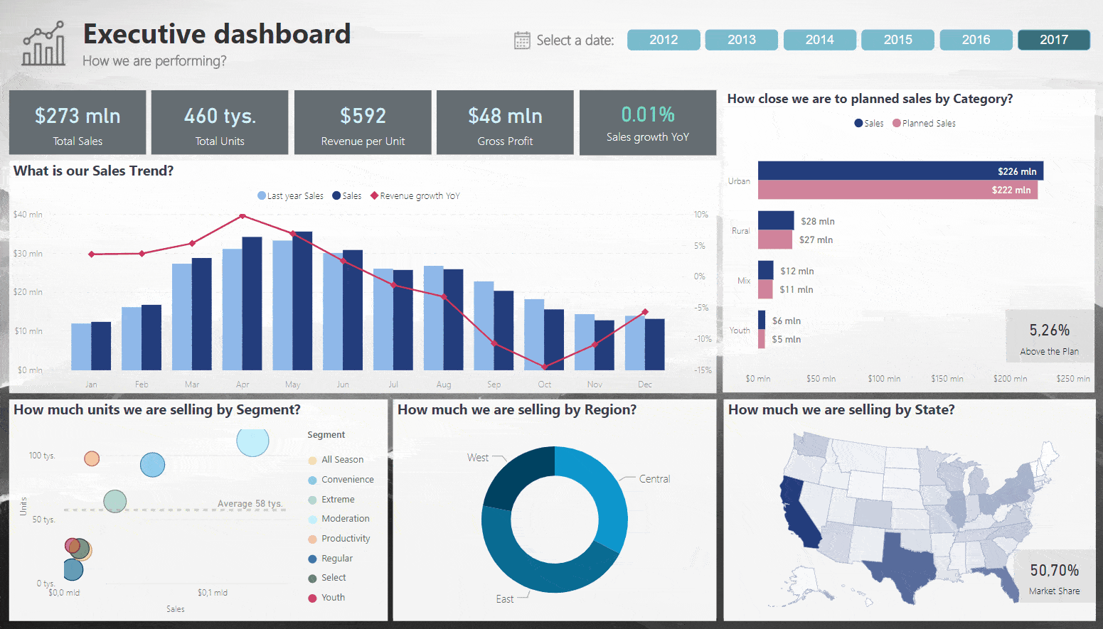
What these mean?
ETL
Analytics
Reporting

Slide 5
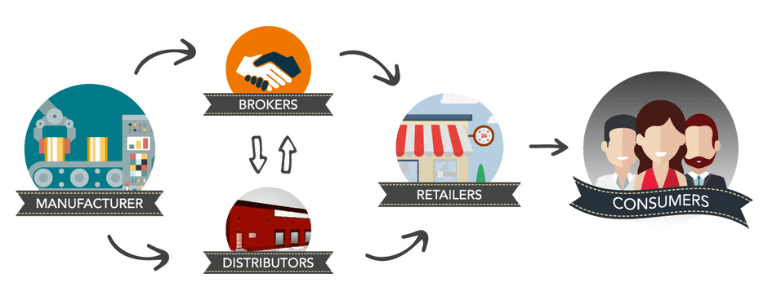

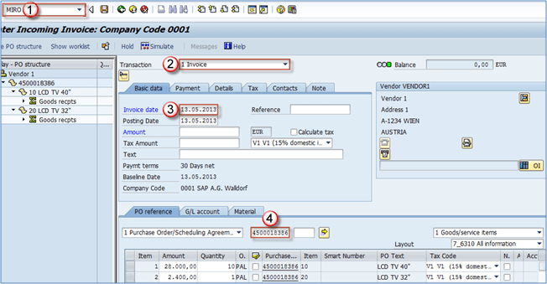
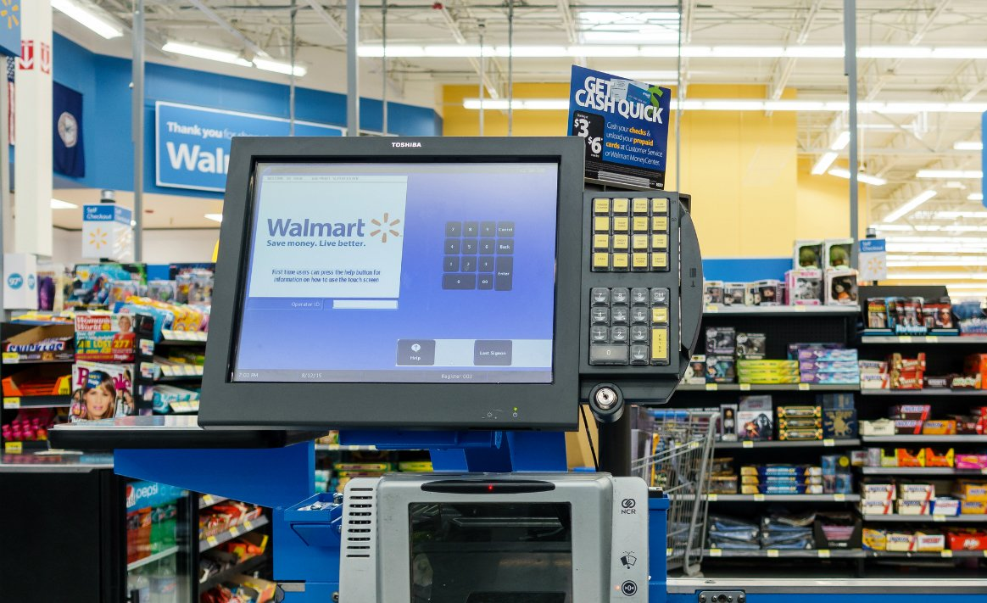
Business Process & Data Collection

Slide 6
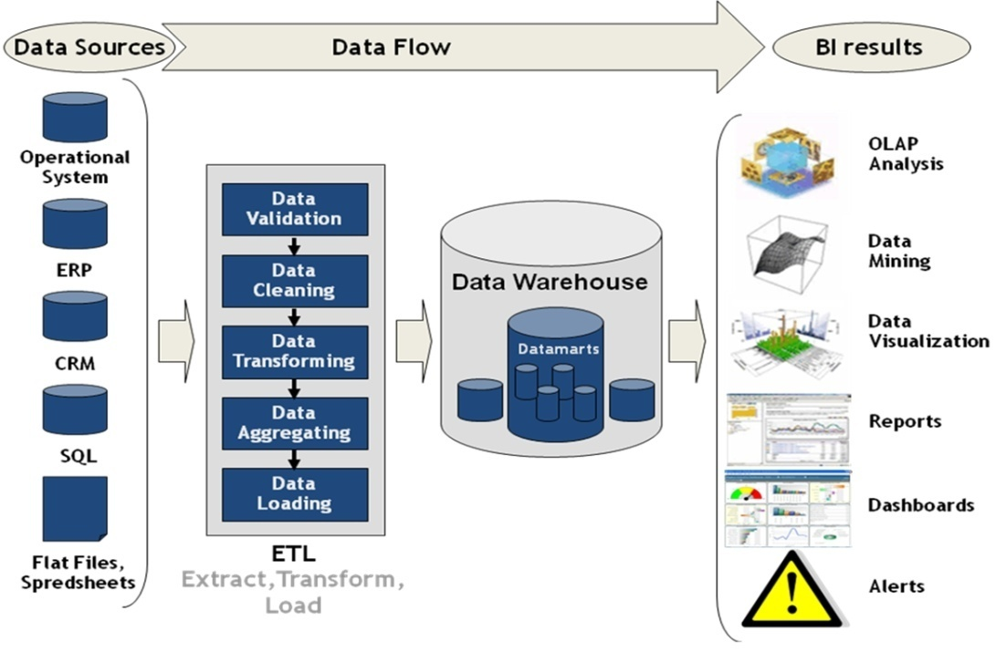
ETL Data flow Diagram

Slide 7
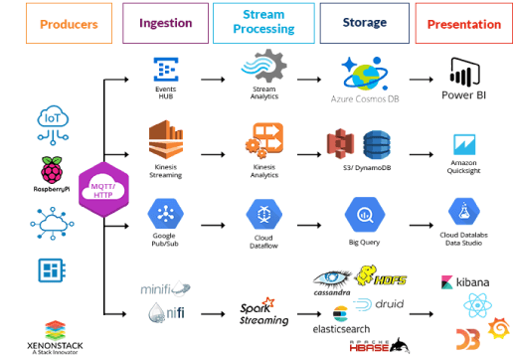
ETL Data flow Diagram – based on technology stack

Slide 8
How to implement BI application – Traditional Approach
Create VM (on premise system)
Install RDBMS instance on that server or get a pre-loaded one.
Schema Design for Source Data
Staging, Clean, Warehouse
Transaction & Master Data
Fact and Dimension
Automation and Orchestration of the Data load process using ETL tool
Reporting from Analysis Services/Cube with a visualization tool

Slide 9
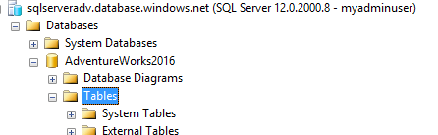
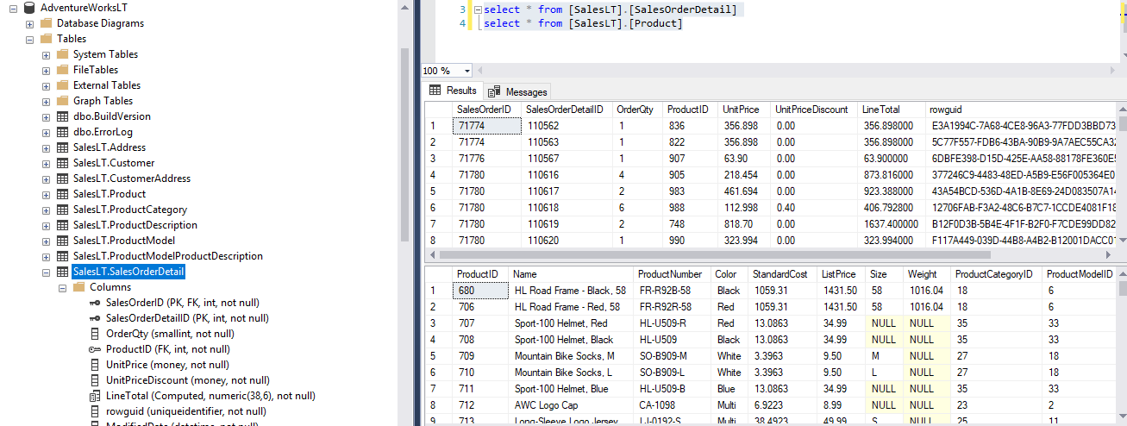
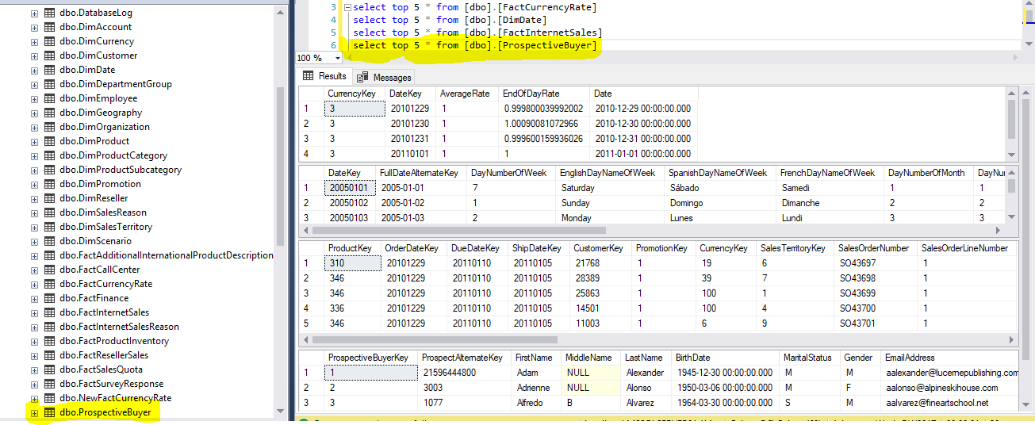
How to implement BI application – Traditional Approach

Slide 10
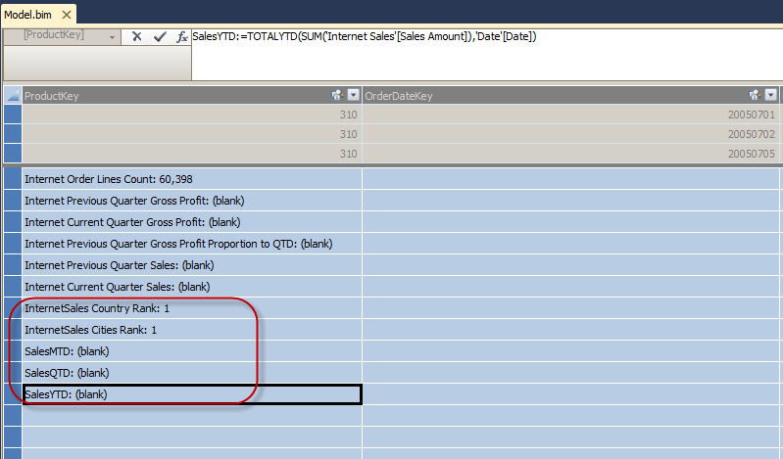
How to implement BI application – Traditional Approach

Slide 11


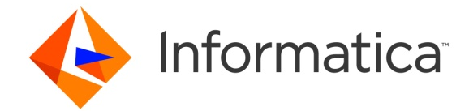

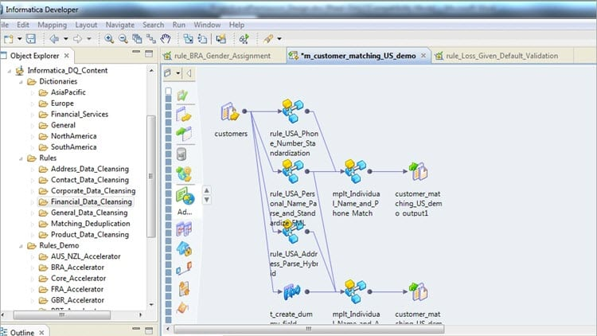
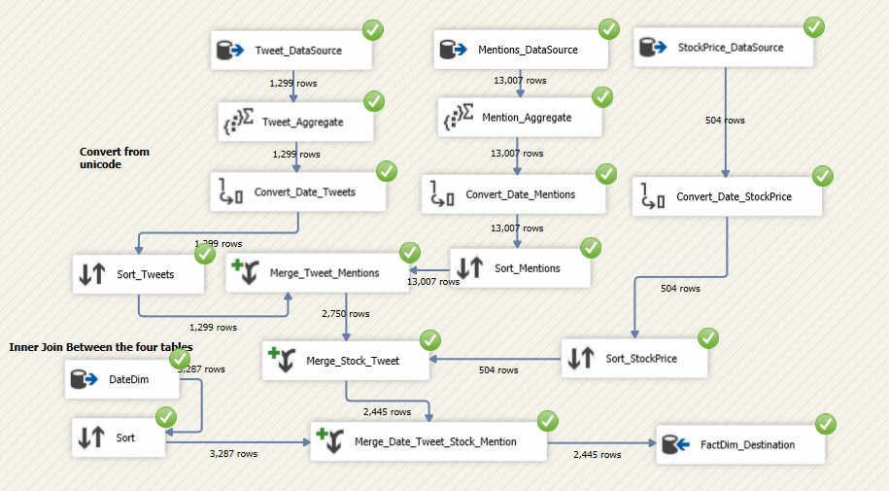
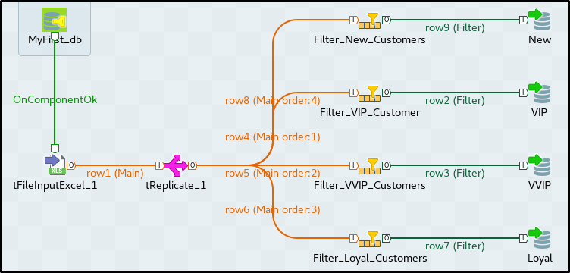
Different ETL tools for On-Premise Systems

Slide 12
Challenges with Traditional Approach
Data volume
Infrastructure limitations – Single machine, cannot scale.
Performance bottleneck.
And many more…

Slide 13
Modern Approach - Hadoop
Set up Hadoop cluster – Hortonworks, Microsoft HDInsight
Create Resources under resource group in azure portal
ADLS,ADF,BLOB
Staging, Conformed, Derived – Enterprise Architecture design
Transaction & Master Data – Placed in BLOB/ADLS
Fact and Dimension – HIVE EXTERNAL TABLE or MANAGED TABLE creation on top of data files in ADLS
Automation and Orchestration of the Data load process using ADF
Reporting from Analysis Services/Cube with a visualization tool like PowerBI

Slide 14
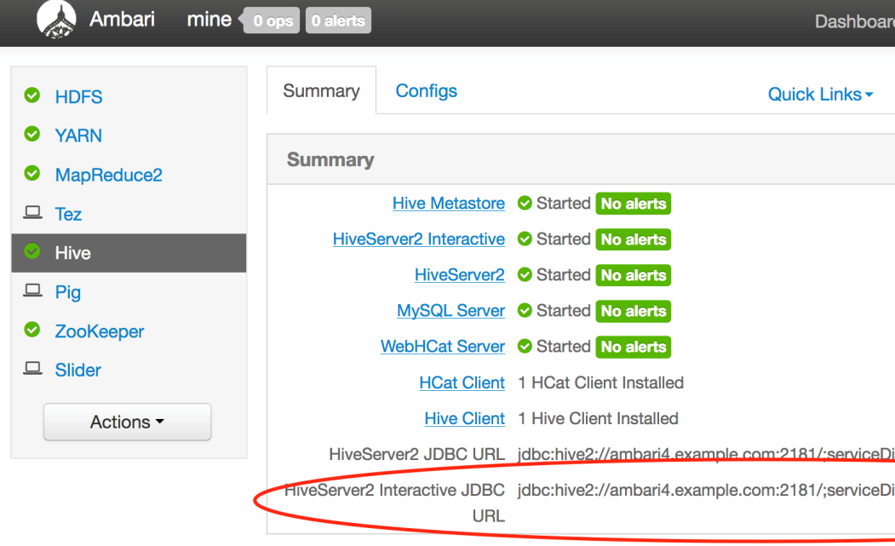



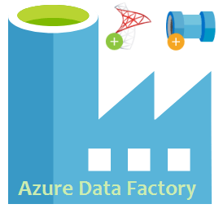
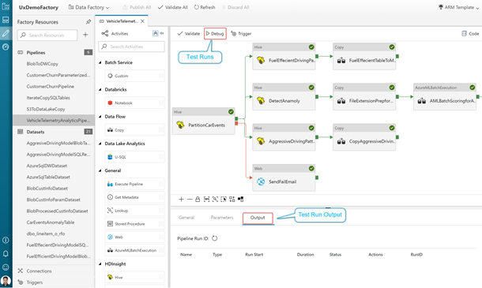
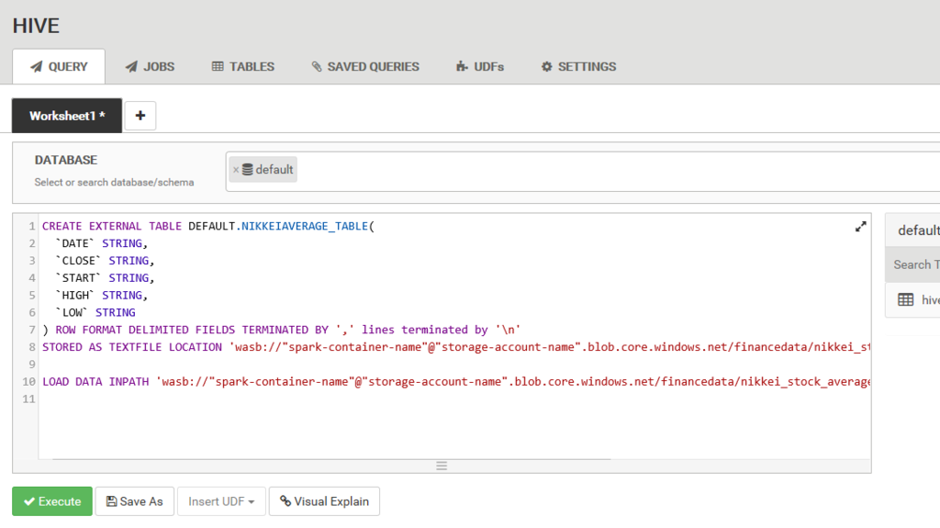
Different ETL tools for Cloud Systems (Opensource & premium)

Slide 15
Challenges with Hadoop way
Slowness due to too much of IO operations
Batch processing only. Problem with streaming handling
Machine Learning on Hadoop was a challenge- reason to create spark

Slide 16
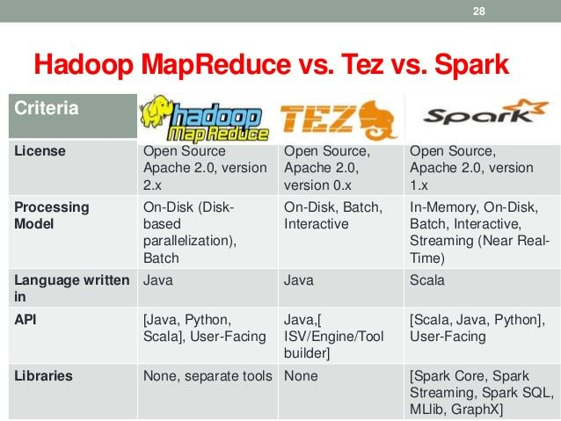
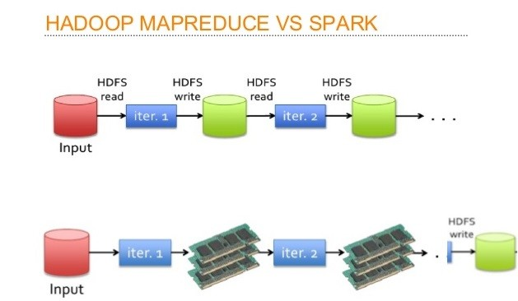
High Level Comparison

Slide 17
Modern Approach - Spark
Set up Azure Databricks
Create Resources under resource group in azure portal
ADLS,ADF,BLOB
Staging, Conformed, Derived – Enterprise Architecture design
Transaction & Master Data – Placed in BLOB/ADLS
Fact and Dimension – Databricks Notebook /Jar using Language APIs
Automation and Orchestration of the Data load process using ADF
Reporting from Analysis Services/Cube with a visualization tool like PowerBI

Slide 18
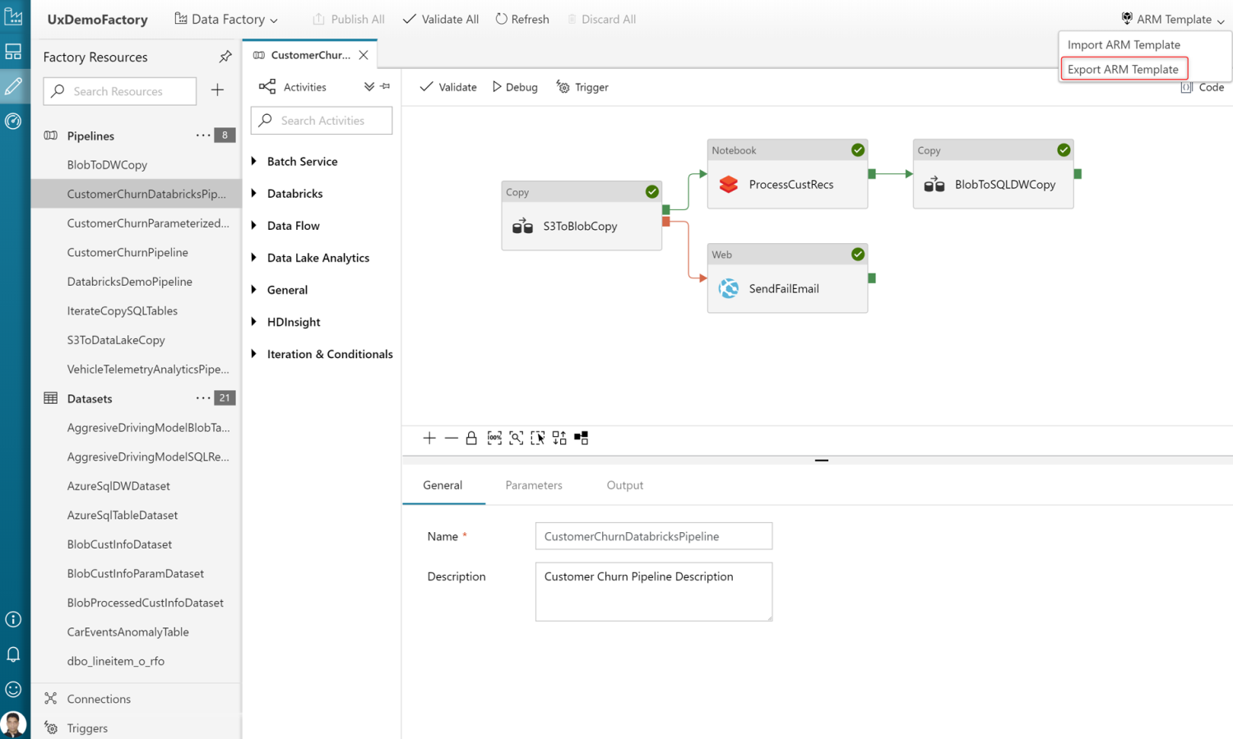
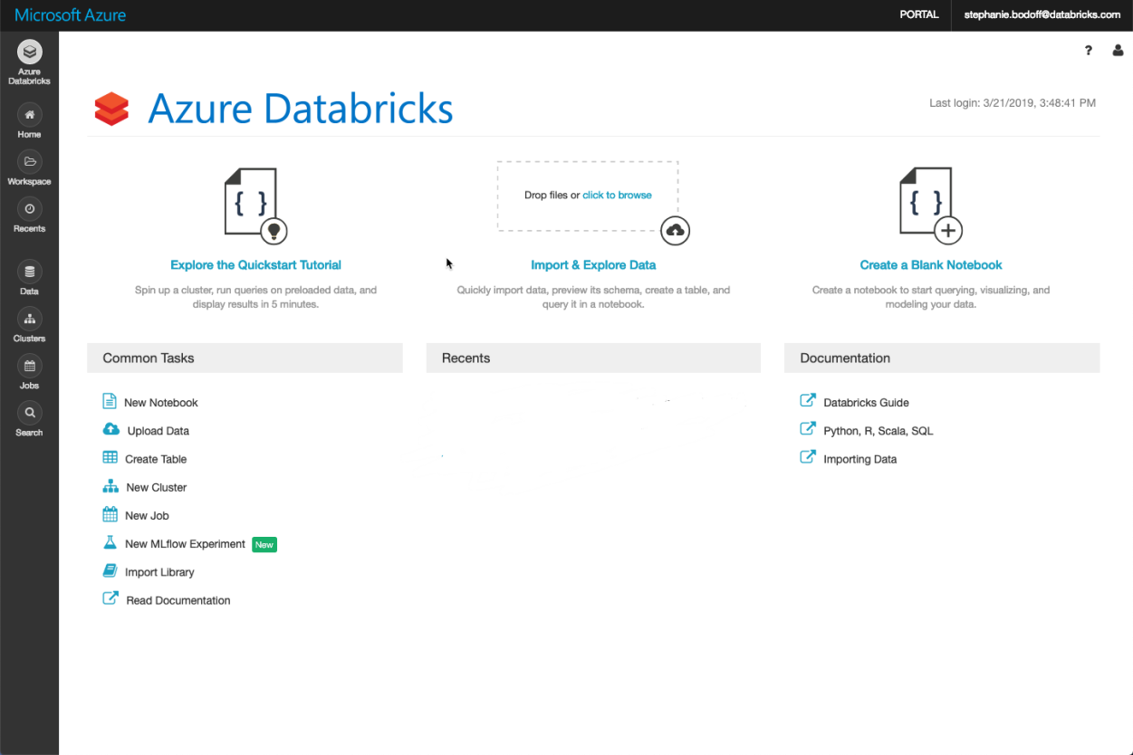
Example notebook
https://pages.databricks.com/rs/094-YMS-629/images/financial-fraud-detection-decision-tree.html?_ga=2.25166205.1922300675.1562386949-1437666804.1562386949

Slide 19
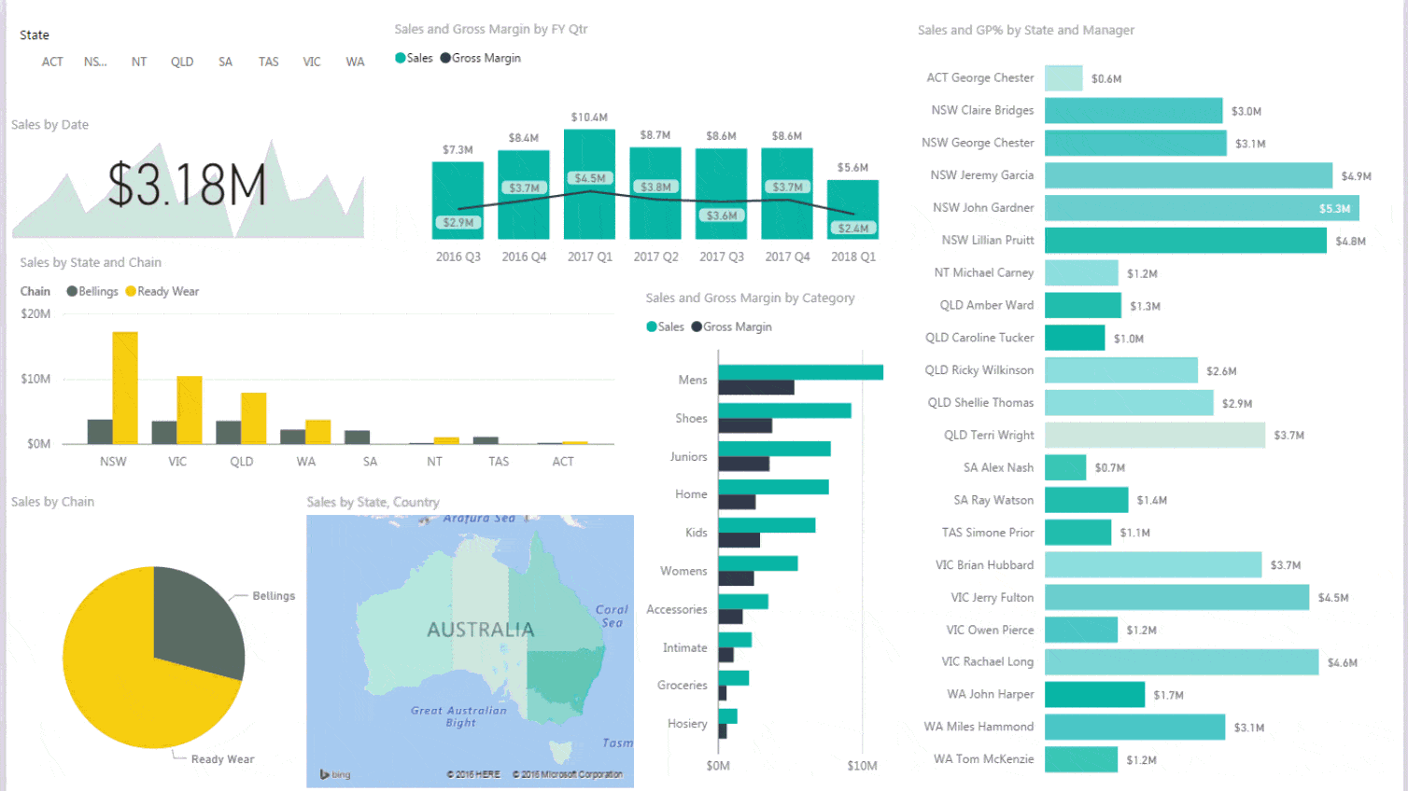

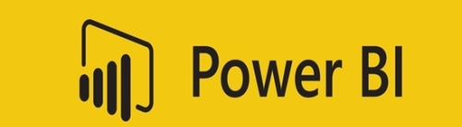

Reporting Tools
User is interacting with the dashboard
but data is static.
(i.e. data is not changing every second)

Slide 20
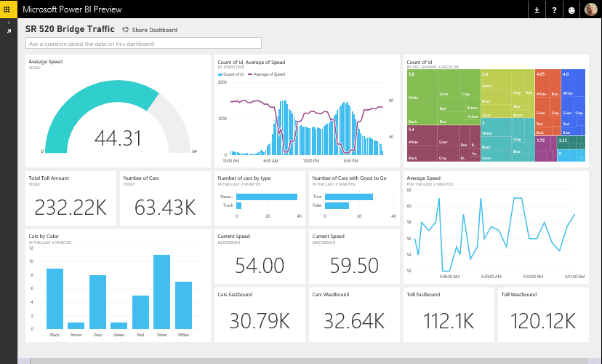
Realtime Analytics on Stream Data (Spark)
Reporting is done on top of streaming data. Hence the calculations are changing every second.

Slide 21
Thank You

